Slide 1
AI verstehen Teil 2

Slide 2
Orga
Jede Kursschiene: Input, kurze Pause und dann Notebooks
Feedback daily
Internet: devolo (Passwort an der Tür) oder Space Internet (Starlink) passwort: spinternet
Kursvibes:
Stellt eure Fragen!
Jargon Catching
Kurssprache

Slide 3
https://github.com/stonehenge0/AI-verstehen-Winteraka-2024-25

Slide 4
Wer seid ihr?

Slide 5
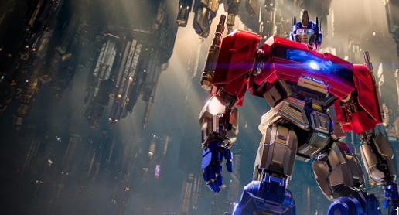
Transformer?
Grundlagen von basically allen LLMs (Large Language Models)
ChatGPT -> Generalized Pretrained Transformer

Slide 6
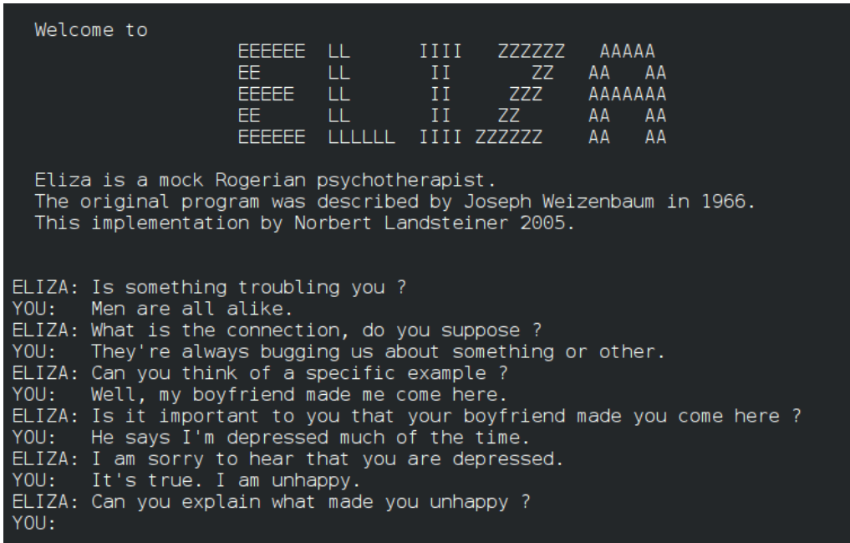
Large Language Models
Chatbots früher waren
ziemlich crap.
Sprache ist
schwierig.

Slide 7
Large Language Models
Warum LLMs?
Chatbots davor waren
ziemlich crap.
Umfassendes Sprachverständnis
Zero-Shot Learning (Warum ist das so krass?)
Hohe Anwendbarkeit in vielen Bereichen

Slide 8
Wie generieren Transformer text?
Transformer predicten das nächste Wort einer Sequenz
The cat sat on the _____

Slide 9
Wie generieren Transformer text?
Transformer predicten das nächste Wort einer Sequenz
Wenn wir das wieder und wieder machen, erhalten wir Text:
The cat sat on the mat ____

Slide 10
Wie generieren Transformer text?
Transformer predicten das nächste Wort einer Sequenz
Wenn wir das wieder und wieder machen, erhalten wir Text:
The cat sat on the mat and ___

Slide 11
Wie generieren Transformer text?
Transformer predicten das nächste Wort einer Sequenz
Wenn wir das wieder und wieder machen, erhalten wir Text:
The cat sat on the mat and yawned.

Slide 12
“ mat”
Aim to understand this box
“The cat sat on the”

Slide 13
Disclaimers
Some details skipped.
All in notebook, either explained directly or in code
Some terminology notes
‘length of vector’ means number of entries of vector. Not length in geometric sense.
‘d’ means ‘dimension’, for example ‘d_model’
No mention of batches. It is not conceptually difficult or interesting
But it does add cognitive load in the code!
No mention of arrays
Arrays are not conceptually the correct object
Arrays package the information for efficient compute
E.g. a 2d-array means three different things in transformers: a list of vectors, a map between vectors, grid of all possible dot products.
Few mathematical formulae
If you’re the kind of person who likes formulae, then optional exercise is to write the formulae.

Slide 14
“ mat”
Sampler
Transformer
Transformer
Tokenizer
“The cat sat on the”
Notes:
First black box in split into three pieces. We are going to work our way from the outside inwards.

Slide 15
Tokenizer
Input: string. Output: list of integers.
[“180”, “876”, “ 1212”, “195”, “ 215”]
Tokenizer part 1
Tokenizer 2nd half
[“The”, “ cat”, “ sat”, “ on”, “ the”]
Tokenizer part 1
Tokenizer 1st half
“The cat sat on the”
Notes:
stress the lack of time and not able to spend time here. Avoid answering questions beyond understanding what is on the slide. Token ids are made up
Often we are lazy and do not clearly distinguish between token and token id. Not a big deal

Slide 16
Sampler
Input: list of floats. Output: token
List of floats is logits. One logit per token in the vocabulary
Many possibilities. E.g. pick most likely, sample according to probabilities,…
“ mat”
Tokenizer part 1
Sample
[0.018, 0.0002,..., 0.8,..., 0.1,...,]
Tokenizer part 1
Soft max
[-2.1, -4.2,...,1.7,..., -0.3,...,]
Notes:
stress the lack of time and not able to spend time here. Avoid answering questions beyond understanding what is on the slide

Slide 17
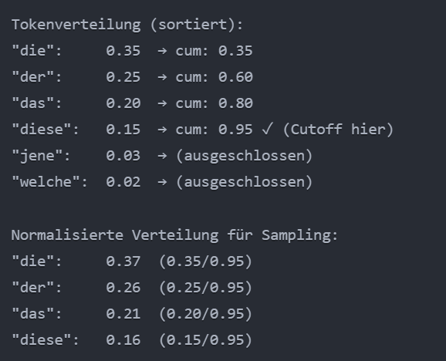
Sampler
Many possibilities. E.g. pick most likely, sample according to probabilities,…
Greedy sampling (most likely)
Temperature sampling (smoothe distribution)
Top-k sampling (choose out of k most prominent)
Nucleus Top-p sampling (choose tokens whose probabilities together reach some value f.e. 0.9)
Notes:
stress the lack of time and not able to spend time here. Avoid answering questions beyond understanding what is on the slide

Slide 18
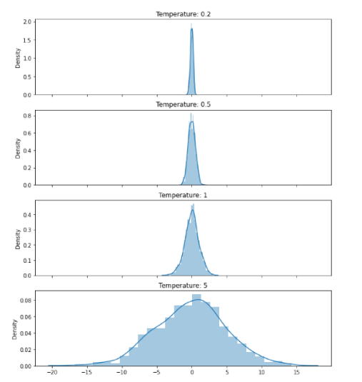
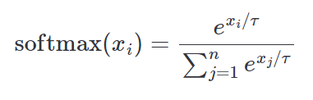
Sampler
Notes:
stress the lack of time and not able to spend time here. Avoid answering questions beyond understanding what is on the slide

Slide 19
“ mat”
Sampler
Transformer
Question:
What do you think is the input and output of the transformer
Transformer
Tokenizer
“The cat sat on the”
Notes:
Say that they should be able to use previous information to answer this. Give enough time for *everyone* to think through previous slides! Don’t just let first person answer for everyone
Answer is on the next slide!

Slide 20
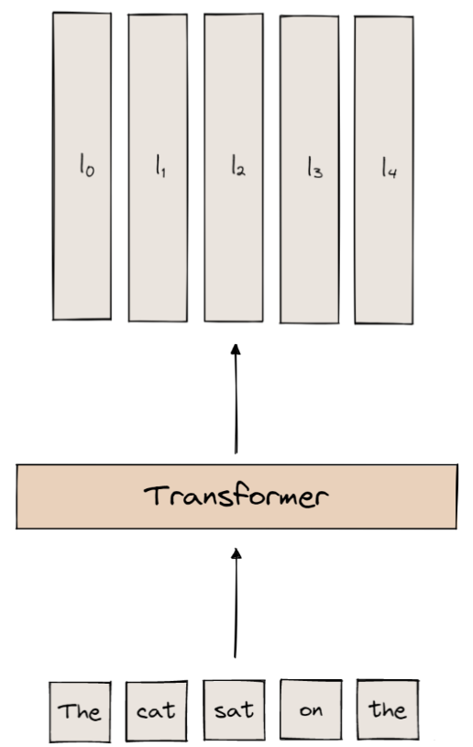
Input: list of tokens / token ids
Output: One set of logits per input token!
E.g. logits for “ on” gives predicted next token for “The cat sat on”
In inference: only final token’s logits are used
In training: all logits used! A single sequence is actually len(sequence) many training points
THIS IS A BIG DEAL!
Notes:
Mention how this is unexpected! Based on previous slides, expect only one set of logits, not many.

Slide 21
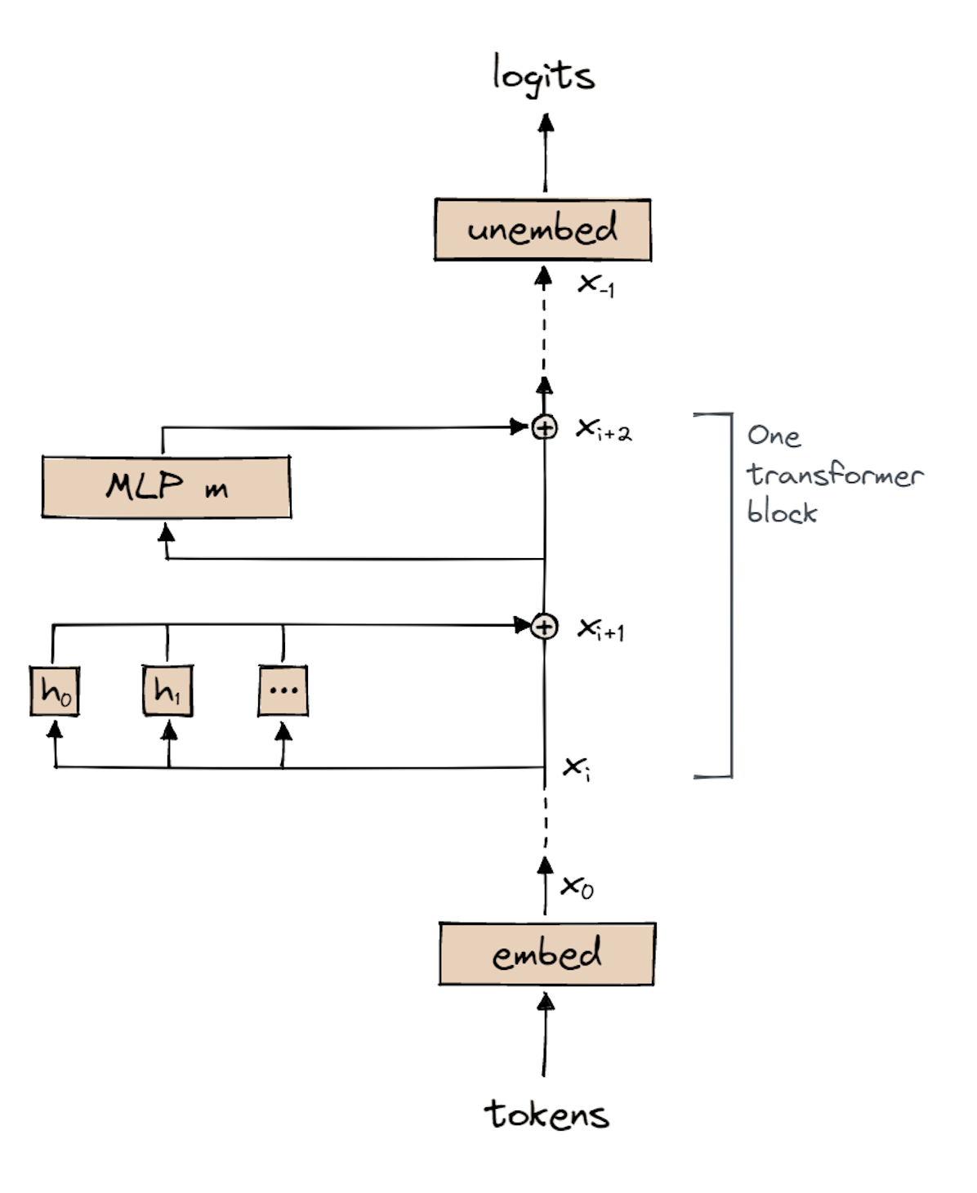
Vertical line of x’s called ‘residual stream’.
x_i is list of vectors, one vector per input token.
Length of vectors is d_model
One Transformer Block:
Attention
MLP
Have n_layer many transformer blocks
Notes:
Residual Strem (Skip Connections), damit nicht Gradienten vanishen bei tiefen neuronalen Netzwerken. Input2 = Transformerd(input) + Input. Im Notfall kann der Gradient immer zurück durch die residual connection.
D_model= “Merkzettel mit Informationen” für jedes Token (gramm, sem.,...)

Slide 22
Embedding
Input: list of ints. The token ids
Output: x_0, list of vectors. One vector per input token. Each vector has length d_model
How?
Lookup table! Each token is associated with a particular vector (embedding)
(Omitted detail: Positional embedding)
Notes:
Repeat that we are working from outside in.
Check word embedding knowledge? -> explain distributional hypothesis

Slide 23
Embeddings background
Wortbedeutung als Vektoren darstellen
Ähnliche Wörter ähnliche Richtung und Länge des Vektors.
-> Flipchart

Slide 24
Unembed
Despite the name, *not* the opposite of embedding
Input: list of vectors. One vector per input token. Each vector has length d_model
Output: list of logits. One set of logits per token.
How?
Weight and bias to get output in desired shape
Important: Same W and b used for each token position.
logits[i] = W_U * x[i] + b_u
Notes:
Unembed: turn transformer representations into a score for each word in the vocabulary. “Translator from Transformer space to vocabulary space”
Sind immer gleiche weight und bias, damit die Translation immer consistent ist across the model.
OOV words, durch sub word tokenization verstanden.
W_U is a matrix of shape (vocab_size × d_model), so (50,000 × 512) eine prototypische Repräsentation edes Vocabs. Wenn eine Sache im Transformerprodukt dme ähnlihc sieht (hohes Skalar) dann meint probably gleiches Konzept.
b_u is a bias vector of length vocab_size (50,000) Grundwahrscheinlichkeiten für jedes Token, unabhängig com Input.

Slide 25
Recap:
What is name of vertical line of x’s?
What is length of vectors in the x’s?
How many vectors are there in each x_i?
What is the input for embed?
How does embed turn its input into vectors?
What is the output of unembed?
How does unembed convert vectors to logits?
Notes:
Residual stream, d_model, amount of tokens, token_ids, lookup table, logits, weights und bias

Slide 26
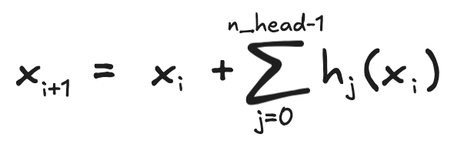
Attention layer
Input: list of vectors. One vector per token. Length of vector is d_model
Output: list of vectors. One vector per token. Length of vector is d_model
Each h_i is an ‘attention head’
Attention heads all independent of each other
All their outputs added to input
Number of heads is n_head
(Detail omitted. LayerNorm)

Slide 27
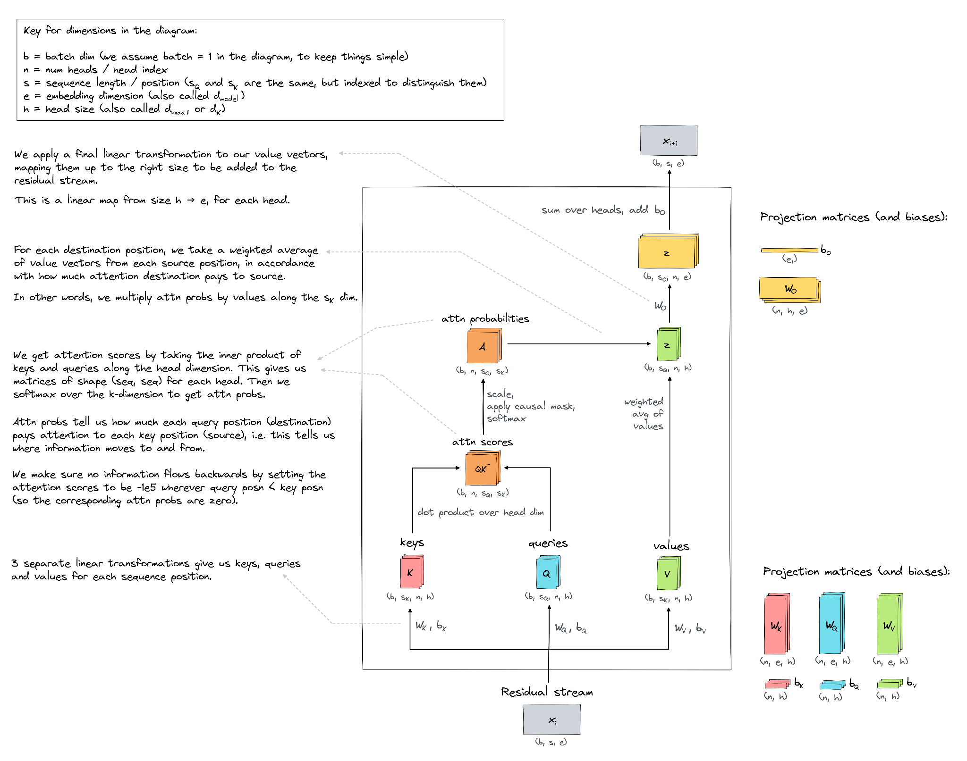
Notes:
Introduce a “motto” for each k,q,v here:
Key: What I am looking for
Query: What I can offer
Value: The actual information that token has to be passer around
Source is Arena’s notebook:
https://www.google.com/url?q=https://colab.research.google.com/drive/1z0aMOrdMG-r8jAILOf588y7uWrp6oPPp%23scrollTo%3Do_WZWukYm4R-&sa=D&source=editors&ust=1727601853930991&usg=AOvVaw0s_E1irCyTF_0dGu9uLvcC

Slide 28
Attention layer
Focus on one head. Call it h
The steps inside h are:
Start with one vector per input token. Length is d_model
Create *three* vectors per token.
Length of these are d_head
Called ‘key’, ‘query’ and ‘value’ vectors
Use K[i] to indicate the key vector for token i. Similar for Q and V
Done using weights and biases. W_K, b_K, W_Q, b_Q, W_V, b_V
Do bunch of calculations (in next slides)
Get one vector per token. Called z
Length of these are still d_head
Go back to residual stream.
So one vector per input token, length of these are d_model
Done using weights and biases. W_o, b_o

Slide 29
Attention layer
Focus on one head. Call it h
Focus on output for one token position, say token position 3.
The final d_head vector for this token:
Z[3] = A[3,0] V[0] + A[3,1] V[1] + A[3,2] V[2] + A[3,3] V[3]
It is weighted-sum of previous tokens’ value vectors
A[3,0] is how much attention token 3 puts on token 0
A[3,0] + … + A[3,3] = 1, and these A’s are all positive
So a probability distribution. What function creates these…
Question. How would this look for a generic token i, not token 3?
Mottos:
Values are information sent from one token to another
A[i,j] is how much ‘attention’ token i is paying to token j

Slide 30
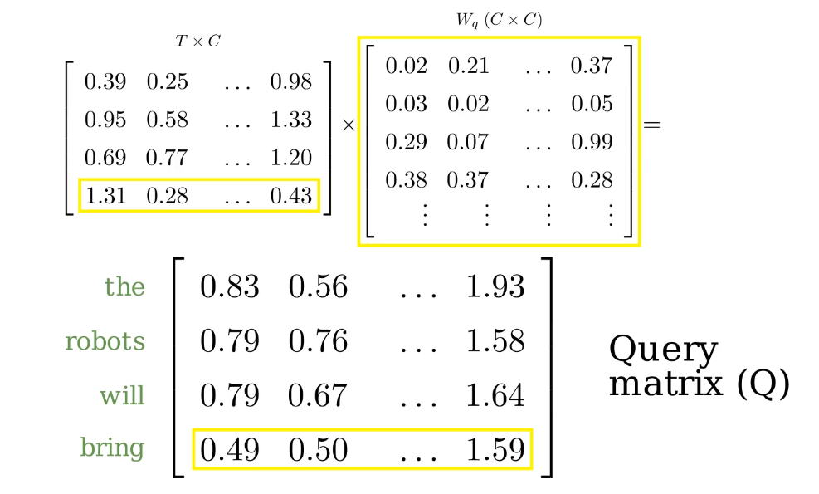
Key, Query und Value berechnen
Notes:
Source for next three slides: https://prvnsmpth.github.io/animated-transformer/

Slide 31
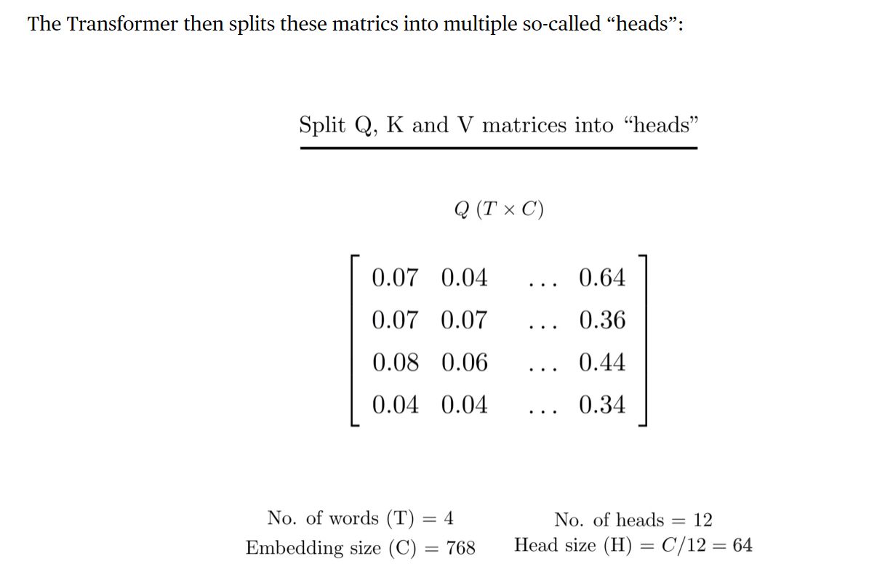
Split into heads

Slide 32
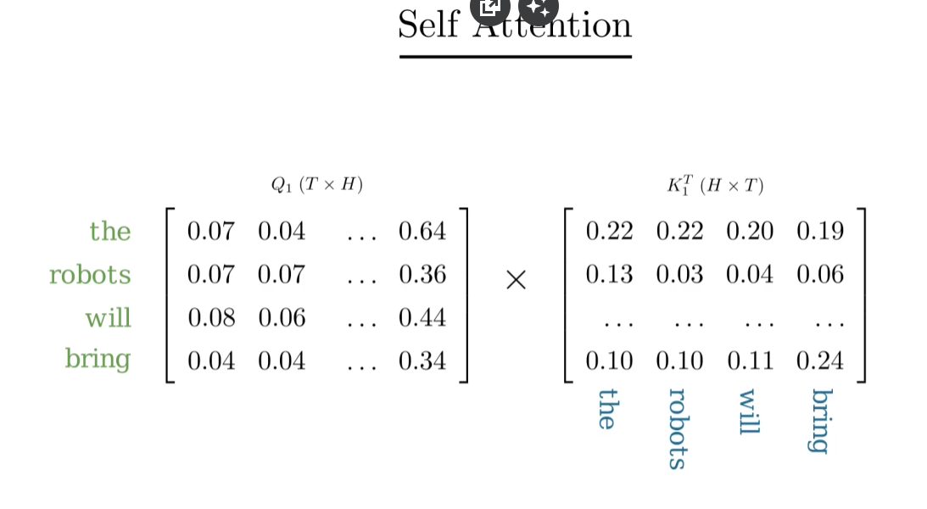
Multiply Key and Query (Dot Product)

Slide 33
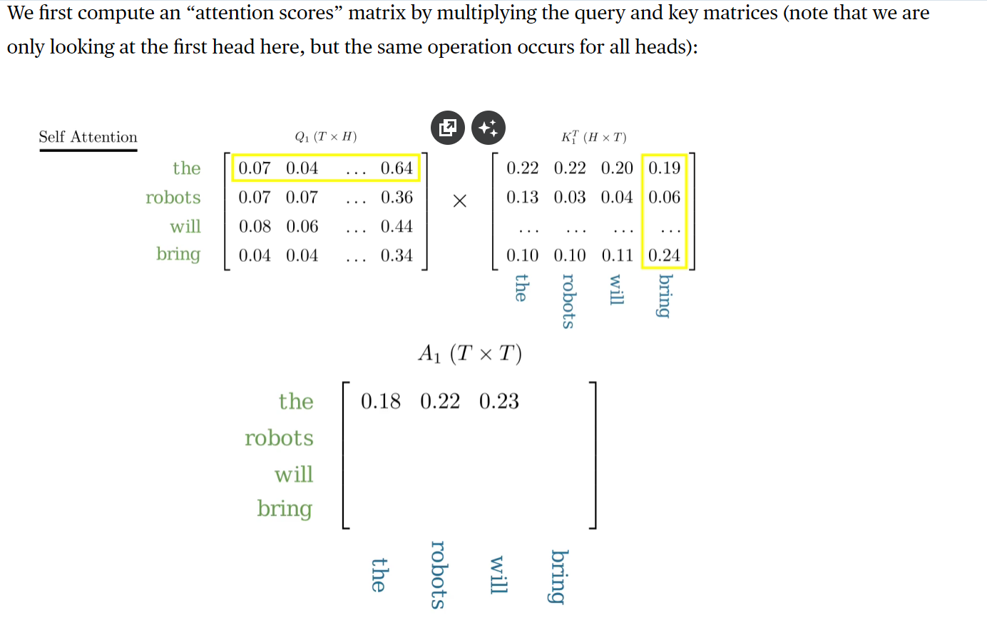
Attention Scores: Multiply Key and Query (Dot Product)

Slide 34
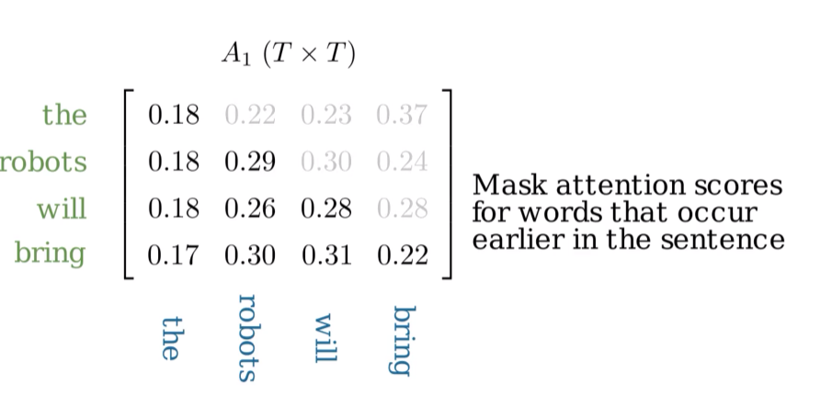
Attention Grid and mask

Slide 35
Attention Scores: Multiply Key and Query (Dot Product)

Slide 36
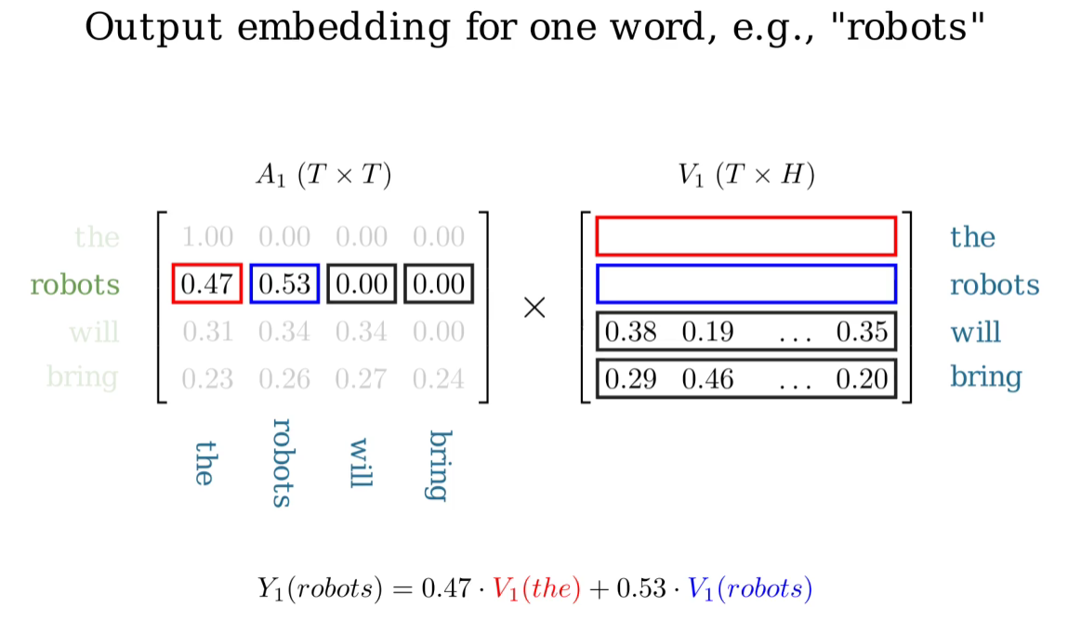
Multiply Values and Attention Scores and pass back to residual stream

Slide 37
Recap:
What is name of vertical line of x’s?
What is length of vectors in the x’s?
How many vectors are there in each x_i?
How does embed turn its input into vectors?
How does unembed convert vectors to logits?
What does + symbol in residual stream indicate?
Notes:
Inside MLP: linear, activation, linear

Slide 38
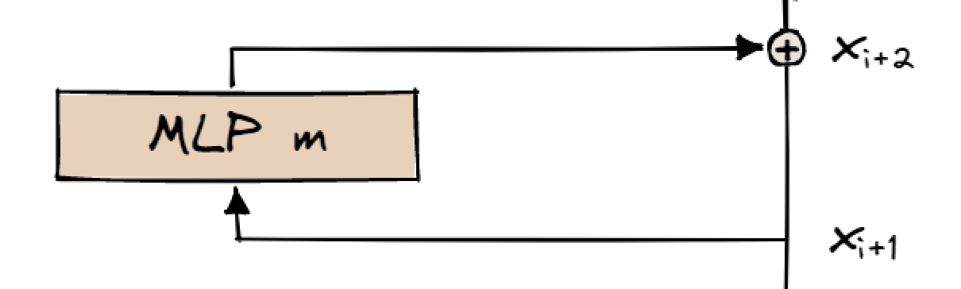

MLP Layer
Input: list of vectors. One vector per input token. Length of vector is d_model
Output: list of vectors. One vector per input token. Length of vector is d_model
x_{i+2} is NOT the output of m
The output of m is added onto the input. Indicated by + symbol.
Known as a ‘residual connection’

Slide 39
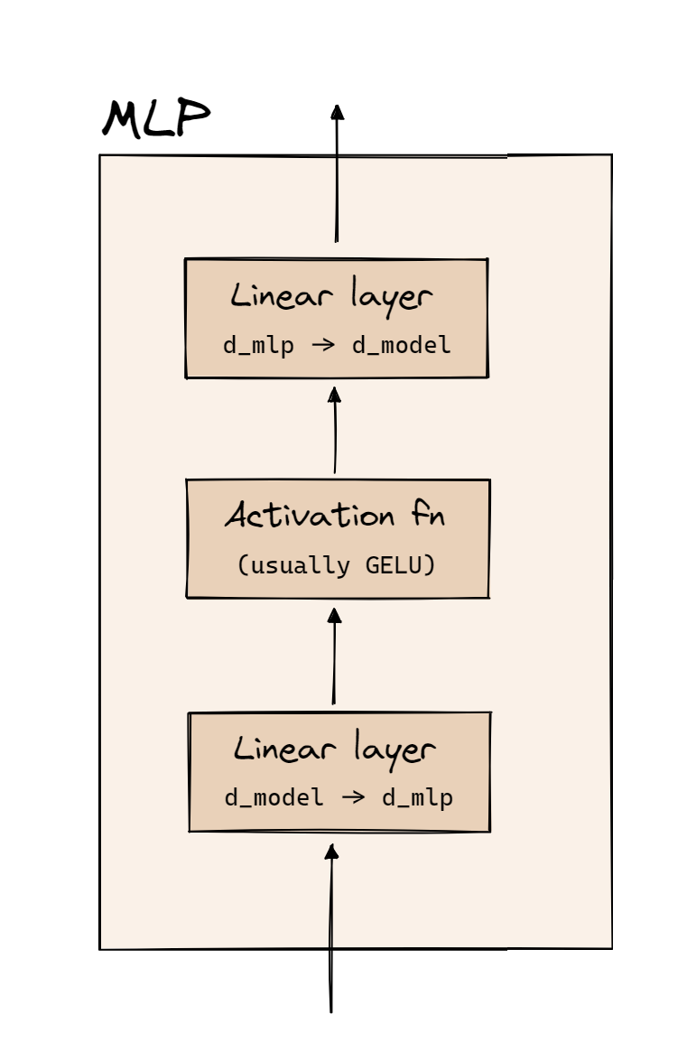
MLP Layer ctd.
Have one vector per input token.
Length of vector changes from d_model to d_mlp then back to d_model
Same as in unembed, tokens are independent throughout these calculations.
(Detail omitted. LayerNorm.)
Notes:
MLP lässt durch die Aktivierungsfunktion NichtLinearität lernen und komplexere Zusammenhänge somit.
Matrixmultiplikation ist nur linear, aber MLP nicht. GELU sorgt dafür, dass kleine INputs fast keine Effekt haben, aber große verstärkt werden, das zB Nonlinearity
Linear Layer bringt einfach Einträge von d_model in ne andere Dimension
Layer Norm, einfach damit Outputs in ner ähnlichen Größenordnung sind. Normalisiert halt.

Slide 40
Attention layer
Focus on one head. Call it h
Recap the steps so far inside h:
Key fact: each token gets *three* vectors, not just one. Can deduce a lot of structure from this.
What are the three vectors called?
How do we get from the d_model vector to these three vectors?
How do we get back to d_model?
For the 5th token, what does z vector look like?
Notes:
We get back to d_model using weights and biases again

Slide 41
Only thing left is calculating A. And we haven’t used K or Q yet…
Key idea: Q[3] dot product K[0] is logit of A[3,0]
Calculate all dot products. Get square grid
‘Causal mask’. Ensure tokens do not pay attention to future tokens
Apply softmax, to get probabilities
Mottos
Query is question that token wants answer to.
Key is question that token has the answer to.
So if Q[3] dot K[0] is large, then 0th token can answer the question 3rd token is asking
And then 0th token passes V[0], ‘the answer’, to 3rd token.

Slide 42
Attention layer
Focus on one head. Call it h
Recap inside h:
What is first step for h?
What is motto for values?
What is motto for A?
What is motto for keys?
What is motto for queries?
Key idea for calculating A[i,j] is…?
Z[3] equals what? (In terms of A and V)
How do we get from z to d_model vectors?
Detail: We have separate W_o for each head, but only one b_o

Slide 43
Notes:
Task:

Slide 44
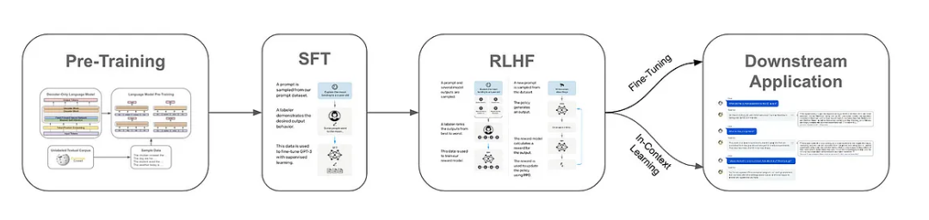
From Transformer to Chatbot
Supervised Fine Tuning -> Chatanfragen
Reinforcement Learning from Human Feedback -> Freundlichkeit und Sicherheit

Slide 45
Fragen?

Slide 46
Notebook
Transformer.ipynb
Transformer from Scratch Implementieren
Fokus auf Attention

